Slide 1
1150 Programming Logic and Design
Chapter 2, first part
Flow Control with if elif else statements

Slide 2
Last Week
Variables
Data types: string, int and float
Print and input

Slide 3
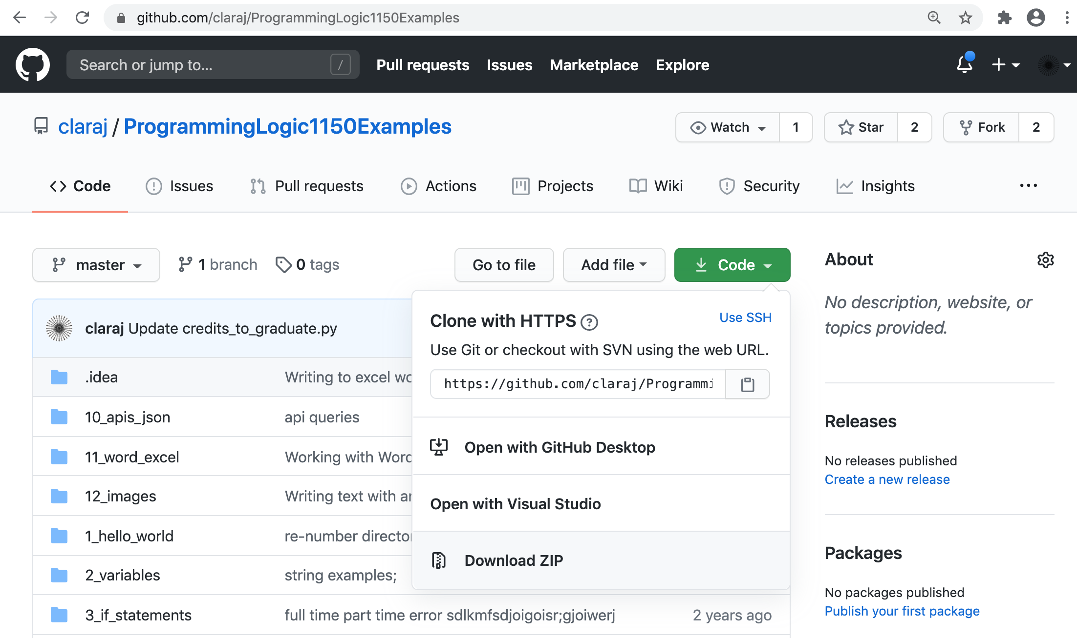
Code examples repository
https://github.com/claraj/ProgrammingLogic1150Examples
You can download everything or browse online. There will be updates and more examples added
It’s a PyCharm project so you can run all the examples
Click green Code button
Click Download ZIP

Slide 4
This week
Flow control: making decisions with if elif else statements
len() function
Blocks in Python

Slide 5
Flow Control - Making Decisions
Open PyCharm
Create a new project
Create a new Python file
See last week's slides for instructions

Slide 6
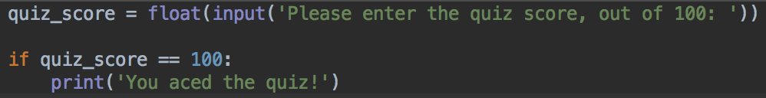
Is something equal to something else?
Quiz score program
Please start a new Python project, and enter this code
Notice that there are two == symbols on the second line
There's a : colon at the end of the second line
The third line starts with a tab
Run and test, enter 100
Run and test again, enter another number
What does the program do?

Slide 7
if statements
When you enter 100, quiz_score stores 100
The if quiz_score == 100: line checks to see if the quiz_score variable is equal to 100 or not
If it is equal, then the line that is indented will run
If it isn't equal, then the line that is indented will not run

Slide 8


if statements
If statements are made of a condition - something that can be True or False
And, some conditional code to run if (and only if) the condition is True

Slide 9


If statement syntax
if
condition
colon
Indent
Conditional code

Slide 10
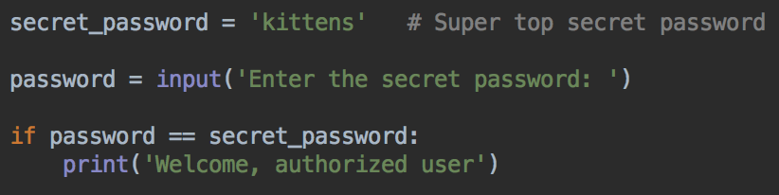


Checking if a string is equal
Create a new Python file
Write and test this password checking program

Slide 11
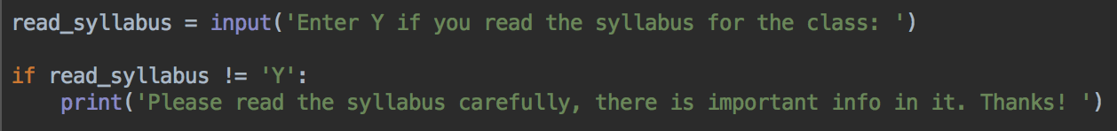
not equal !=
Use the != operator to check if something is NOT the same as something else

Slide 12
Writing conditions - comparison operators
Check if two things are equal with ==
Check if two things are not equal !=
Check if something is less than something else with <
Check if something is greater than something else with >
Check if something is less than or equal to something else with <=
Check if something is greater than or equal to something else with >=

Slide 13
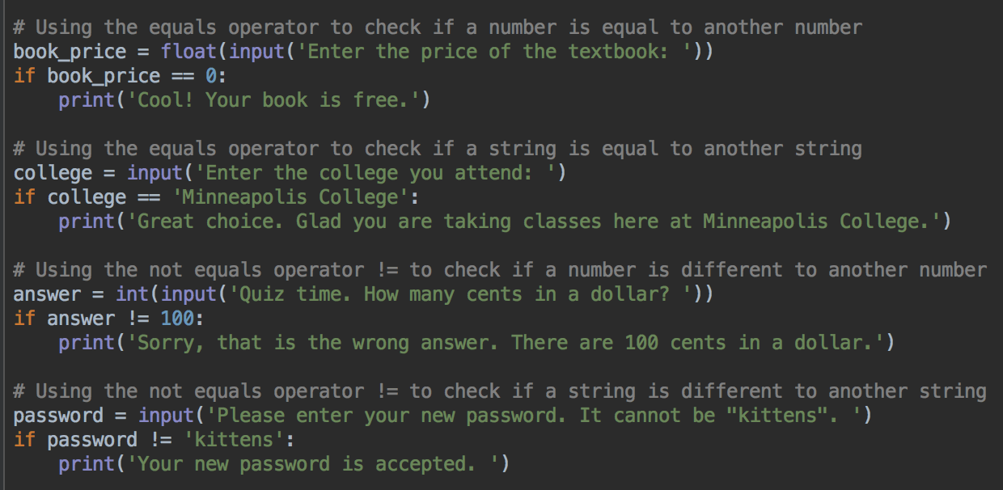
Comparison operators examples, == and !=

Slide 14
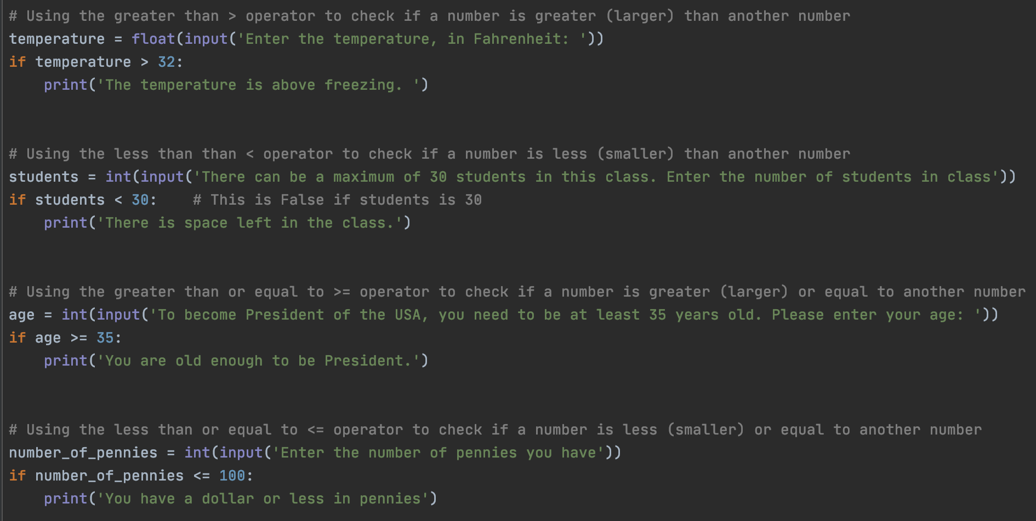
Comparison operators examples, < > <= >=

Slide 15
if else
Often, you want to do one thing if a condition is True, but do something else if it is False
For example, a password checking program needs to print a welcome message if the password is right, but print an error message if it is wrong
To do that, need to add an else block to an if statement

Slide 16
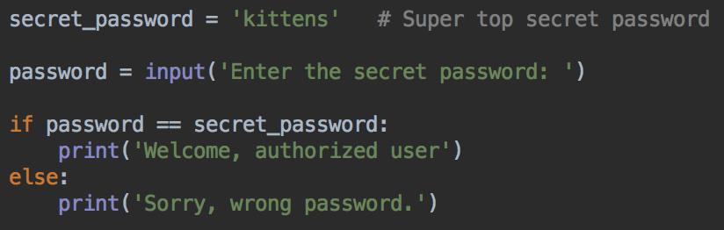
if else - password checker
Modify your password program to print a different message if the password is wrong
Watch the indentation and : after else

Slide 17


if else - password checker
Run and test password program
Try the right password - should see the welcome message
Try a wrong password - should see the error message

Slide 18
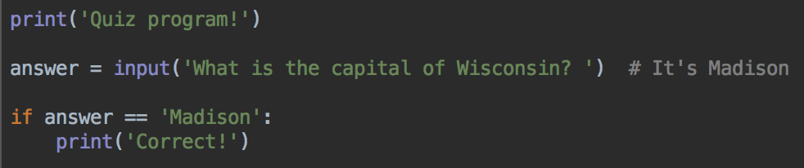
if else - quiz program
Start a new Python program
Enter this code
Run and test - should print the 'Correct!' message if the right answer is entered

Slide 19
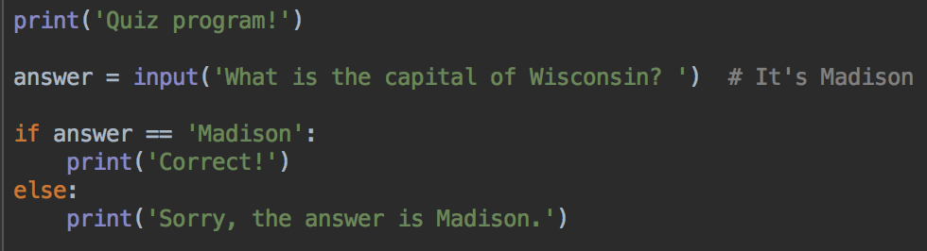
if - else quiz program
Add an else block to print a different message if the user enters the wrong answer
Run and test, verify the expected message is printed

Slide 20
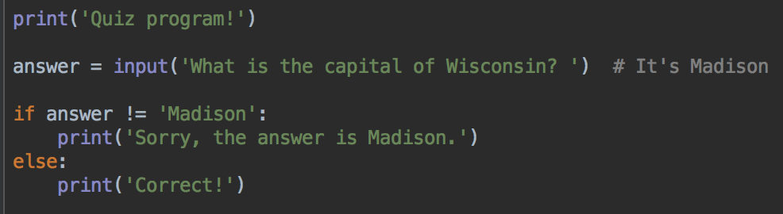
Many ways to express the same logic
This is the same as the previous version of the quiz program
Uses the != operator to see if the answer is wrong first, otherwise it must be correct

Slide 21
Is a student a full-time student?
Various things depend on if a student is taking classes full-time or not
Scholarships, financial aid, possible tax deductions…
Let's write a program to identify if a Minneapolis College student is a full-time student, or not

Slide 22
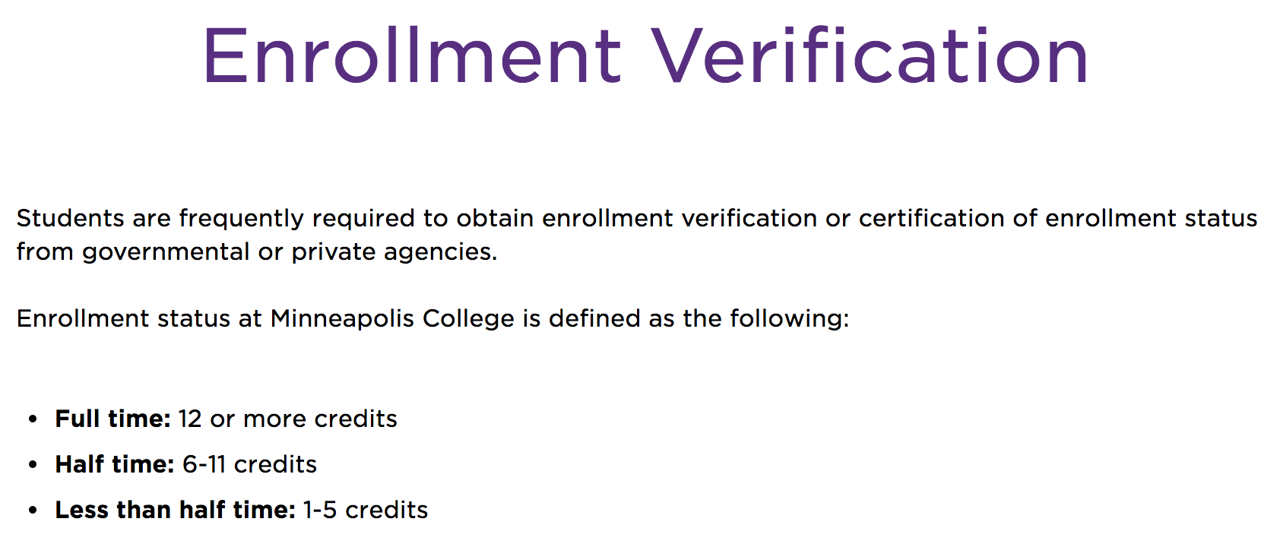
Program design!
Start by thinking about requirements
And data you need for the program
So, how does Minneapolis College define a full-time student?
12 or more credits = full time
6 - 11 credits = half time
5 or less = less than half time
https://www.minneapolis.edu/student-services/registration-and-records/records/enrollment-verification

Slide 23
Requirements – starting the program
Ask the user to enter the number of credits they are taking this semester
The program will decide if they are full time

Slide 24
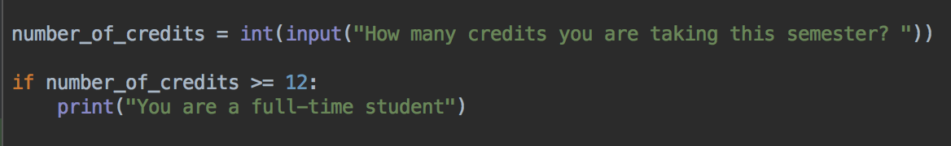
Code
In PyCharm, enter this code
Notice the 3rd line
print('You are a full-time student')
is tabbed (indented)
Run and test, enter some example data (e.g. 12, or 14)
Try running it again with some different example data (e.g. 0, or 5)

Slide 25
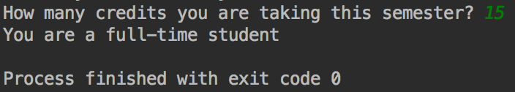
Example output
If you enter 15, should see the "You are a full-time" student message

Slide 26
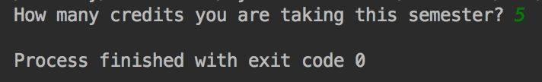
Try again, this time enter 5
No output, no message

Slide 27

Remember: If statements
Asking Python to check a condition
If that condition is true, execute some statements
If that condition is not true, don't execute the statements
This code says, "if number_of_credits variable is greater or equal to 12, then print the message "You are a full-time student"

Slide 28
Not a full-time student?
Let's print a different message if the student is not a full-time student
Perhaps we can use an else block?
Yes, but, there's more than one way to not be a full-time student
We should have a message for half time and a different message for less than half time

Slide 29
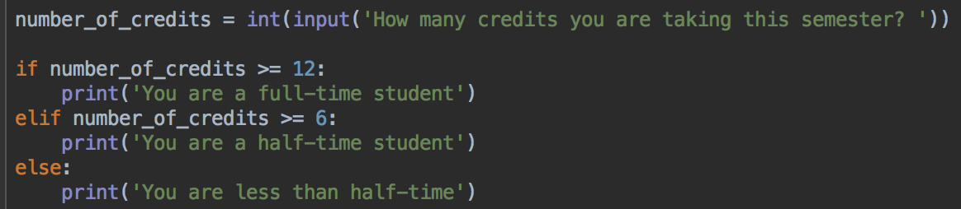


if - elif - else
Modify your program and add an elif and an else block
Run and test with different numbers

Slide 30
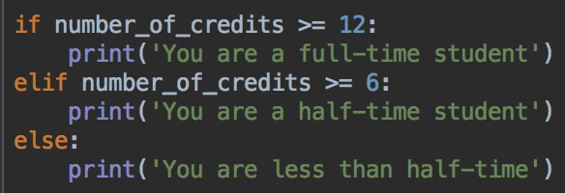
if - elif - else
If the if condition is true, run that conditional code
otherwise, check the elif condition. If the elif condition is true, run the elif conditional code
otherwise, run the conditional code for the else block
Check this
If not true, check this
Neither are true? run the else code

Slide 31
if - elif - else
Why does the elif condition only need to check that the number of credits more than 6? Why doesn't it check that it is less than 11?
Because if the first if condition is true, the rest of the checks are skipped
So if the elif condition is being checked, the first if condition must be false
So the number of credits can't be 12 or more
And the elif just needs to check if the number of credits is >= 6
Check this
If not true, check this
Neither are true? run the else code
The code from only one of the choices will run
And, code from exactly one of the choices will run.

Slide 32
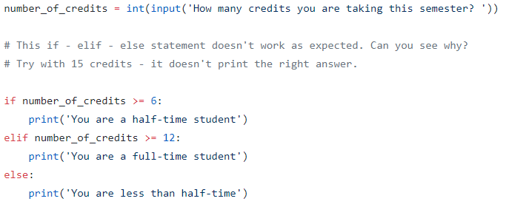

If – elif – else order matters
If you swap the order of the conditions, what happens?

Slide 33
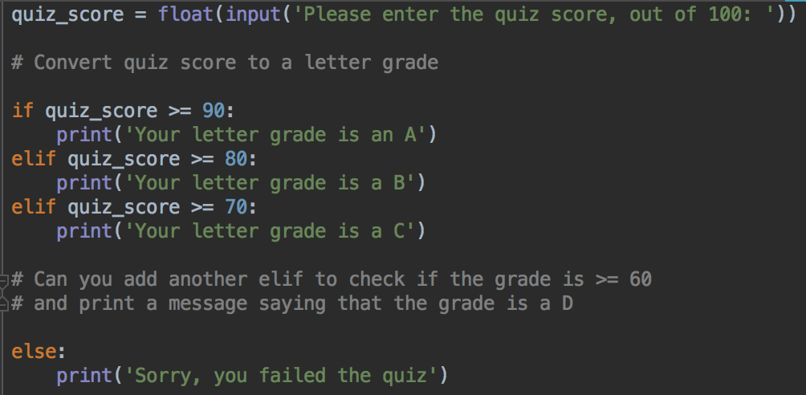
if elif else Letter grade calculator
Can you finish this program by adding the missing elif?

Slide 34
len()
Question - a program needs the user to enter their starID
A starID is 8 characters, for example, ab1234cd
How can we test if they entered the right number of characters?

Slide 35
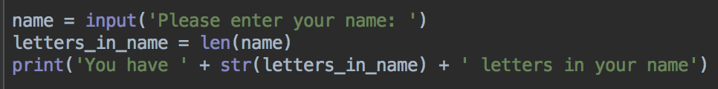

The len() function
Counts the number of characters in a string
Start a new python program
Enter this code, run and test. Is it counting the number of letters in your name correctly?

Slide 36

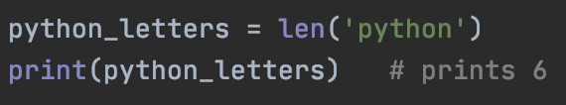
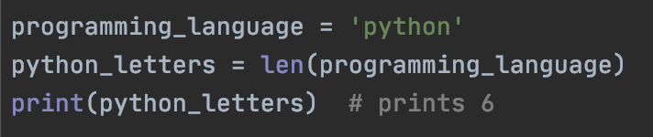
len()
The len function count the number of characters in a string, and return the number, as an int variable
Can count letters in a string literal or string variable
Can print the number, save it in a variable and use it in your program

Slide 37
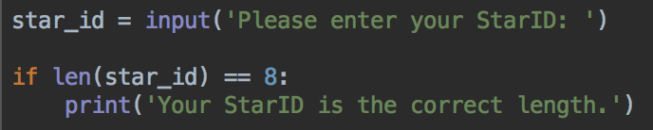
Using len() and if together
Start a new Python program
Enter this code
Run and test
Can you add an else block to print a different message if the StarID is the wrong length?
Can you modify your program to use an elif and else block to print different messages if the StarID is too long, or too short?

Slide 38
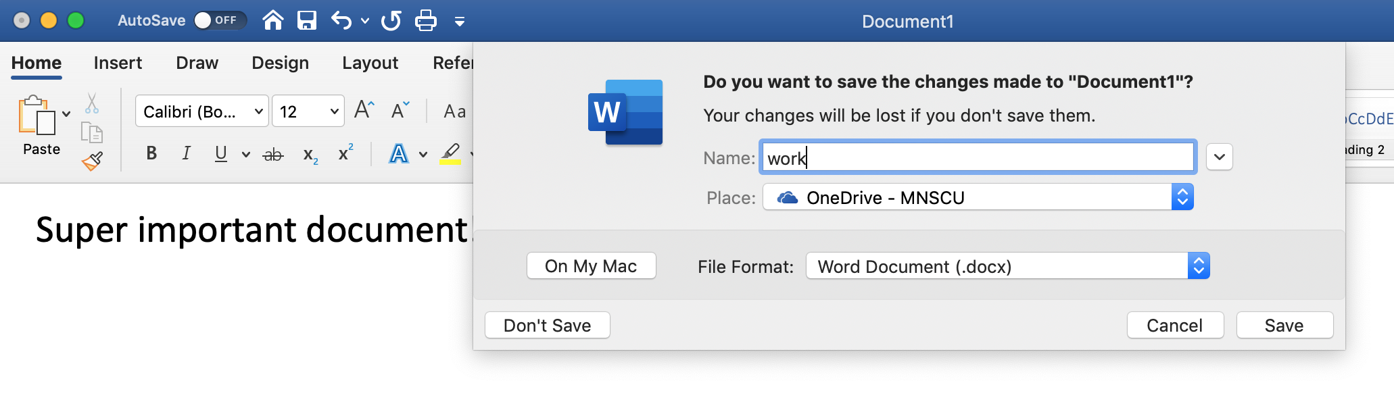
Checking more than one thing
Can check if more than one condition is true using the and operator
Check if at least one condition is true using the or operator
Has the user made changes since they opened the file?
AND is their work unsaved?
Display a save dialog

Slide 39
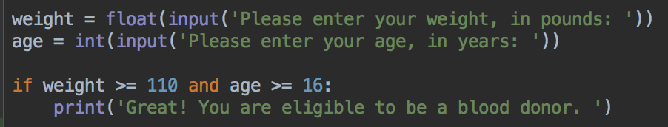
and
Does a person meet requirements to donate blood?
To donate blood, you must be at least 16 years old, and weigh at least 110 pounds
Your turn: can you add an else and print a different message?
To think about: how would you print a specific message about why the user is not eligible – too young, does not weigh enough, or both?

Slide 40
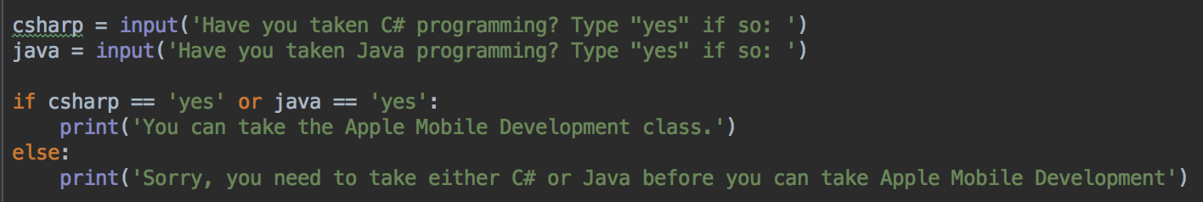
or
To take our Apple Mobile programming class, you have to take at least one of the pre-requisite classes, Java Programming or C# programming
So you have to take one or the other (or both)

Slide 41
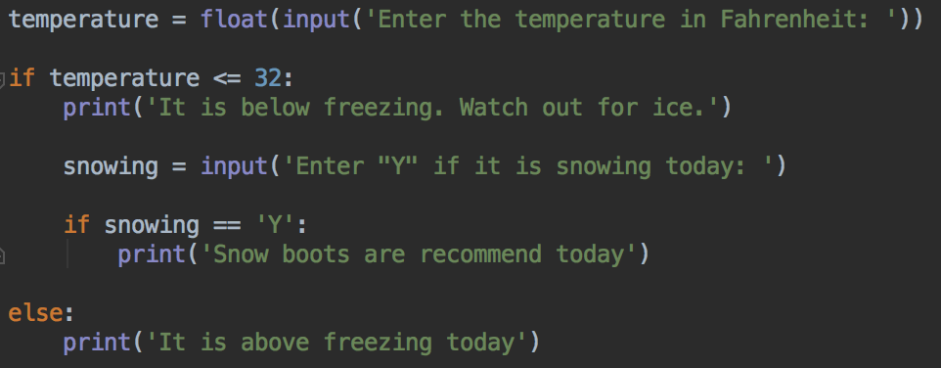
Nesting if statements
Can write if statements, and other code, inside an if, else or elif block
Blood donor eligibility: Would this idea help you print a specific message about why the user is not eligible – too young, does not weigh enough, or both?

Slide 42
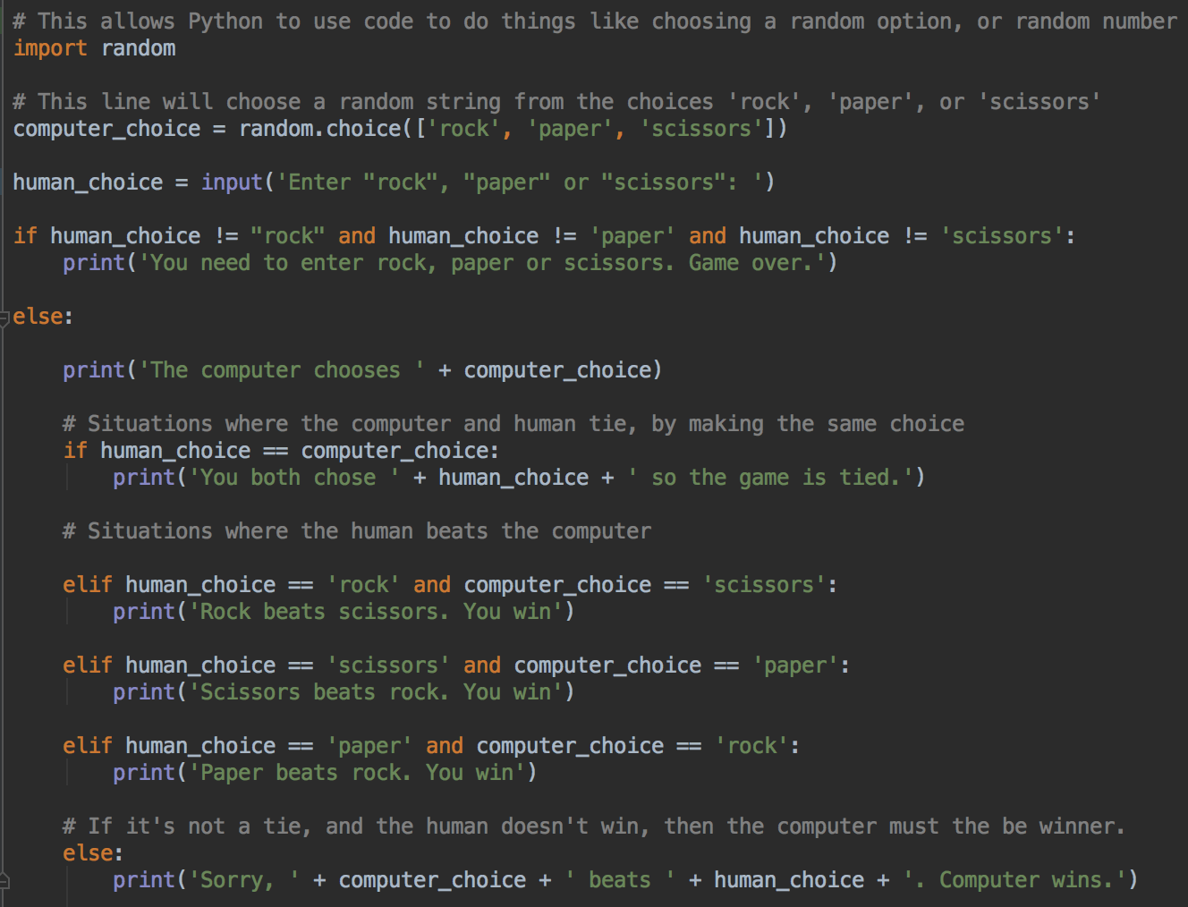
Rock, paper, scissors
Uses nested if statements
There's another if-elif-elif-elif-else inside the first if-else
Also making a random choice for the computer

Slide 43
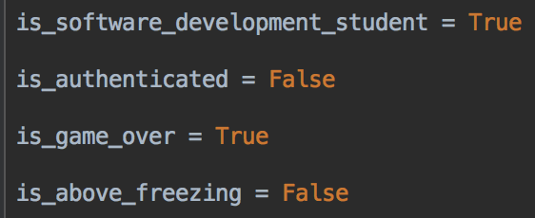
Boolean Values
We already know int, float, and str
Another data type is bool
bool is for storing Boolean values
A Boolean value is one of the two values True or False

Slide 44
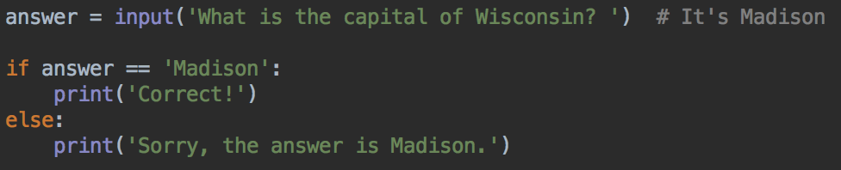
Using bool variables in if statements
Remember that an if or elif statement has a condition
Python will check the condition and decide if it is True or False
And then, that decides which code to run

Slide 45
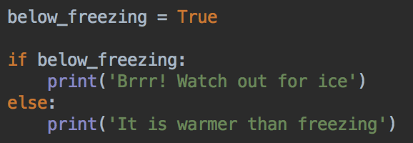
So, we can use a Boolean value in a condition
For example,
It is correct Python to write the condition as below_freezing == True but it's more typing. The version above is preferred.

Slide 46
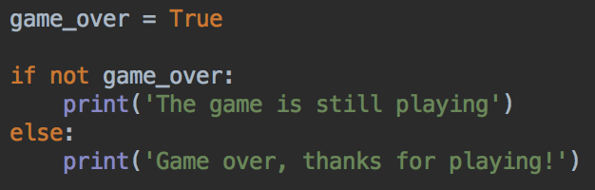
Checking if a Boolean is false with not
It is also correct Python to write the condition as game_over == False
but it's more typing. not game_over is slightly preferred.

Slide 47
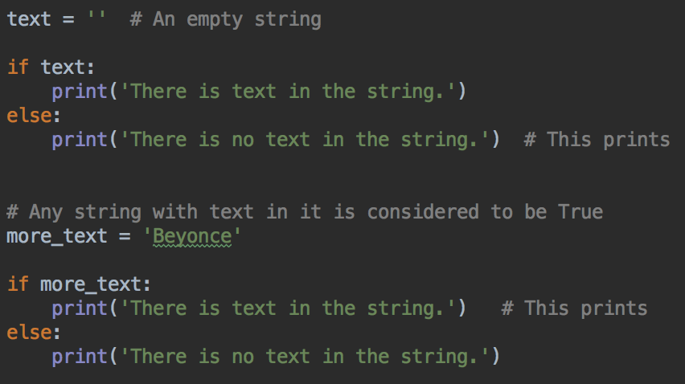
Truthy and Falsy values
Empty strings are considered to be false, strings with at least one character are true

Slide 48
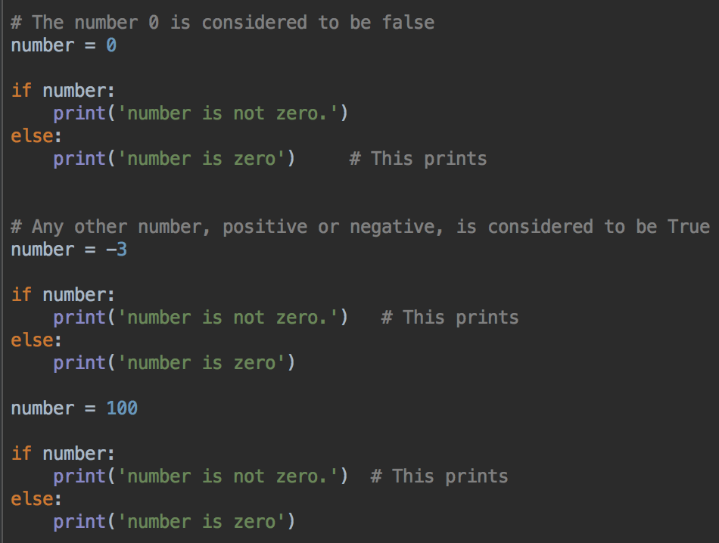
Truthy and Falsy values
The number 0 is considered to be false, any other number is true
Empty strings are also falsy

Slide 49
Lab 3
In D2L
Write the programs
Start now, if time, finish at home
Submit your programs to Lab 3 assignment dropbox before next class
Questions? Need help? Ask me, or one of the tutors

